Slide 1
Multi-device Content Display & Smart Use of Annotation Processing
@gdigugli
@dbaeli

Slide 2
Speakers
@dbaeli
@gdigugli
Java developer since 1999
R&D Team Mentor at
Coder, DevOps, Agile Coach
From idea to production
eXo Platform
VP Quality
Java developer since 1999
Software architect at
ILOG - IBM
2D graphic toolkit
Rule engine
Prima-Solutions
Services platform for J2EE
Domain models code generators

Slide 3
Let’s talk about visible quality
Effective Content Display

Slide 4


The case
Effective Content Display
Multi device & languages
Labels
Layout & images
Clean code
Strong Quality
Easy Maintenance
with APT Tooling
APT Engine
APT Processors
Generate technical code
Generate reports
Generate Helpers
based on i18n
@Message
@MessageBundle
https://github.com/dbaeli/ez18n

Slide 5
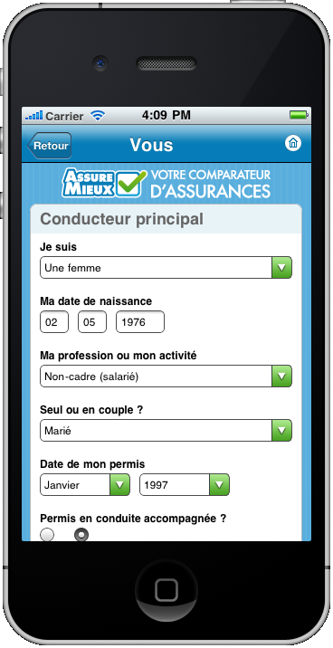
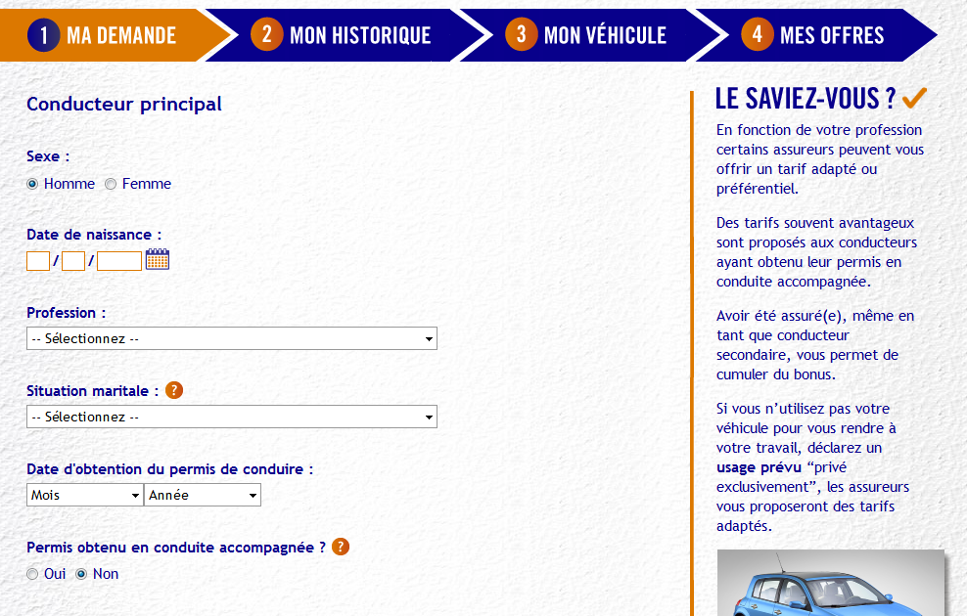
mobile & desktop

Slide 6
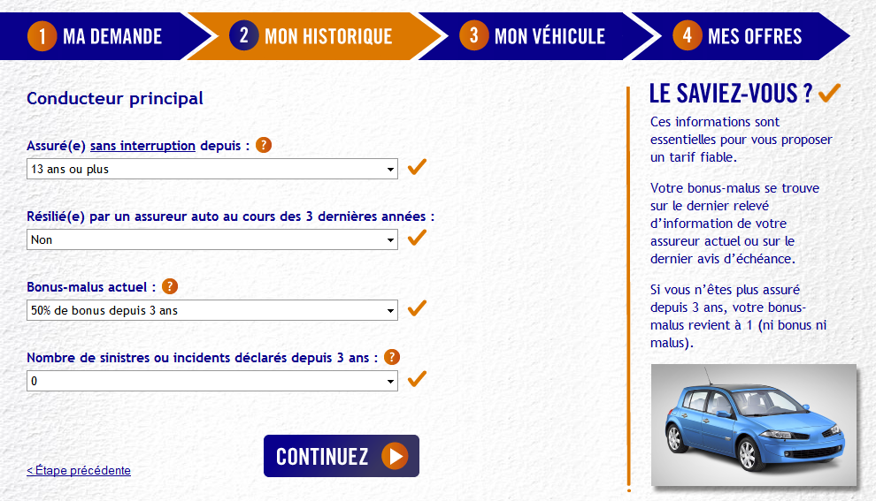
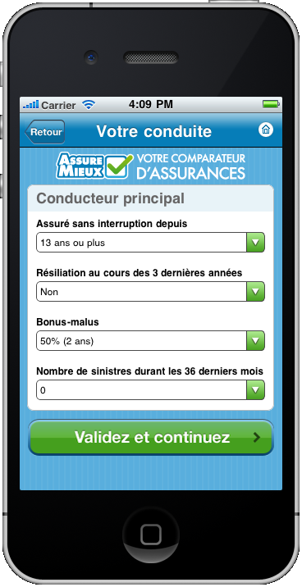
mobile & desktop

Slide 7
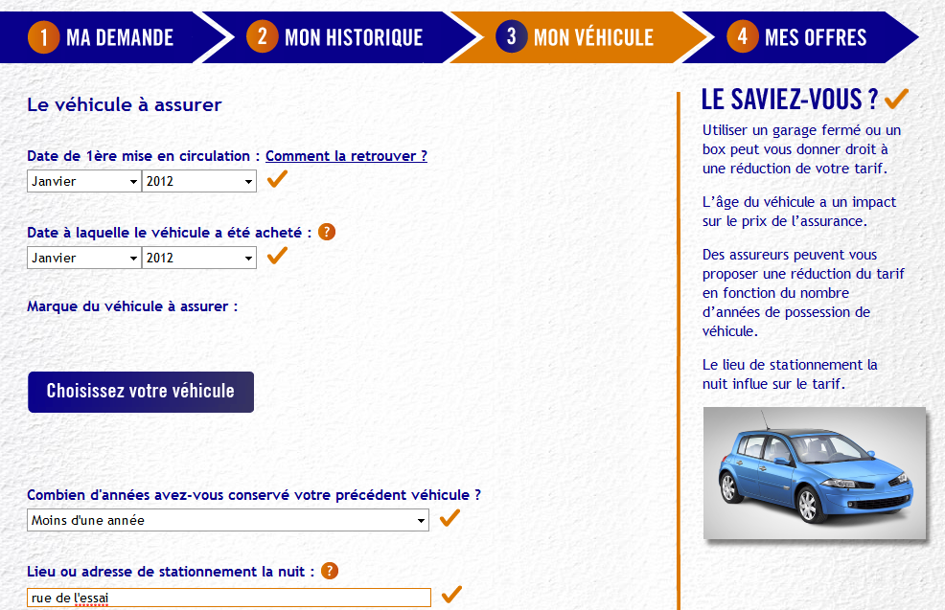
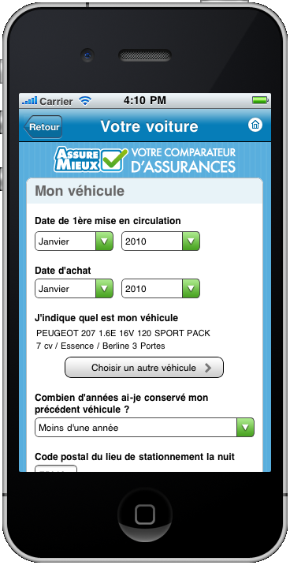
mobile & desktop

Slide 8
How to manage text display ?

Slide 9
Java i18n pattern
The provided tooling for :
Dynamically bind the content
Texts, but also CSS and images (urls)
Tooling :
java.util.ResourceBundle : for .properties reading
java.util.MessageFormat : tiny templating
.properties files with naming pattern

Slide 10
java.util.ResourceBundle
The .properties loader for a given Locale
Key / Value in .properties
Naming convention for the storage
Messages_en_EN.properties
Language
Country

Slide 11
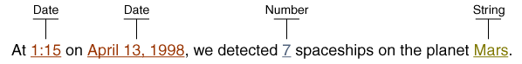
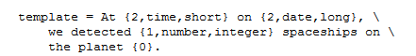
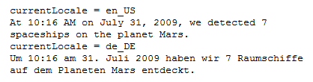
java.util.MessageFormat
Tiny templating
format(“<pattern>”, args)
Date, numbers are formatted according to the Locale
Options, conditional values easy to use

Slide 12
.properties issues
Low quality control
Keys are strings in the code
Poor IDE support
No warning on unused or wrong keys
Encoding Hell
use \uxxxx or you’re in trouble
Forces you to maintain two files in sync
key declaration / value in .properties
Key usage in the .java files

Slide 13
Improved i18n

Slide 14
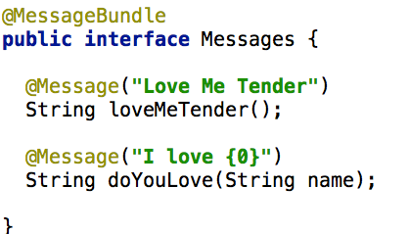
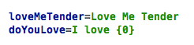
Improved i18n
Interfaces representing each set of .properties
The methods acts as keys
Messages.java
Messages.properties

Slide 15
Annotations and Code generation
Same pattern as in GWT, but for J2SE
Annotate your code :
@MessageBundle to mark interfaces
represents a ResourceBundle
@Message to mark methods
represents a localization key
Generate :
.properties file (for ‘default’)
A ResourceBundle for each .properties
Manage other languages out-side your code

Slide 16
Improved i18n benefits
Now you can
Refactor your keys
Maintain the ‘default’ in Java
Never change a .properties file for default locale
And use it with other libs:
GWT (done on GitHub)
Even JQuery, Dojo, CoffeeScript (planned)

Slide 17
Extend this pattern for Multi-display

Slide 18
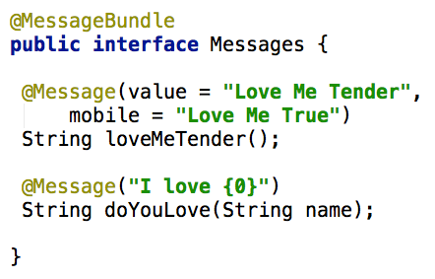
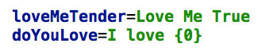
Extended to displays
Add mobile support in @Message declaration
DesktopMessages.properties
Messages.java
MobileMessages.properties

Slide 19
Extended to displays
One ResourceBundle by kind of display
All driven by @MessageBundle annotation
Fallback on the default display
Keep the plumbing generated

Slide 20
APT to generate .properties and ResourceBundle classes from annotations

Slide 21
Behind the scene How APT works

Slide 22
APT basics
APT - Annotation Processing Tool
Kind of old-school pre-processing
But not on the file it-self
No runtime overload
Based on annotations in source code
Standard since JDK 1.6 (available in Sun JDK 1.5)

Slide 23
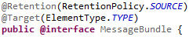
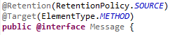
APT annotations
Use @Retention, @Target

Slide 24
APT Processors
javax.annotation.processing.Processor
Code parsing similar to Reflection
No need of compiled code
Some limitations
2 key elements :
@SupportedAnnotationTypes to declare the matching annotations
FileObject : the future generated file

Slide 25
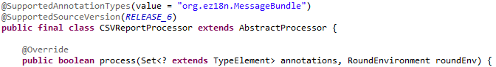
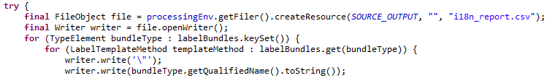
Processor code sample
Processor declaration
Use a FileObject to generate the content

Slide 26
Similarities with java.lang.reflect
Java.lang.reflect | Javax.annotation.processing
java.lang.Class | TypeElement
Constructor | ExecutableElement
Field, Parameter | VariableElement
Method | ExecutableElement
java.lang.Package | PackageElement
NO Class.newInstance()
NO instanceOf, NO isAssignable()
NO getConstructor, getMethod, …
Weak inheritance management

Slide 27
APT command line
javac
-cp $CLASSPATH
-proc:only
-encoding UTF-8
-processor $PROCESSOR
-d $PROJECT_HOME\target\classes
-s $PROJECT_HOME\target\generated-sources\apt
-sourcepath $SOURCE_PATH
-verbose
$FILES
-proc:none
processors fqcn list
optional

Slide 28
APT tooling
Maven integration
maven-processor-plugin (google-code)
Ant integration
javac
IDE integration
Extend the JDK compilation options

Slide 29
APT usages
Generate required repetitive code :
Not always possible at runtime
Unit tests, JMX declarations
Utility code with coverage and debug
Build your reports on your code
Your Metrics without runtime overload
Even fail the build if you want !

Slide 30
One or Two phase compilation
One phase
APT runs during the compilation
Generated code is directly produced as bytecode (.class)
Harder to debug (no .java created)
Two phases
javac with proc:only then with proc:none
Creates .java files in the sourcepath
Not really supported by IDEs, ok with maven.

Slide 31
Caveats of APT
Beware of the “Generate” golden hammer
generate needed code
APT Processors can be tricky:
hard to test / maintain
bad error management (hidden errors !)
Not really (well) documented
No built in templating mechanism
Enforced file path creation
Beware of maven // builds
javac is not thread safe

Slide 32
It’s time to convince your team
APT parses the source code to generate
Java Files & .class, Reports (.csv, …)
Build log information or even build failures
It allows you to have a source level DSL
Annotate your code
Generate the plumbing
Compile / Debug the real code
APT framework is compact
Learning curve is low

Slide 33
Go deep in Ez18n

Slide 34
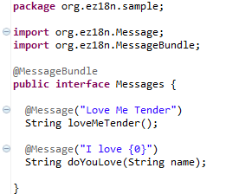
Ez18n - Getting started
@MessageBundle is triggering each processor
@Message is supporting the default localization

Slide 35
Ez18n - Big picture

Slide 36
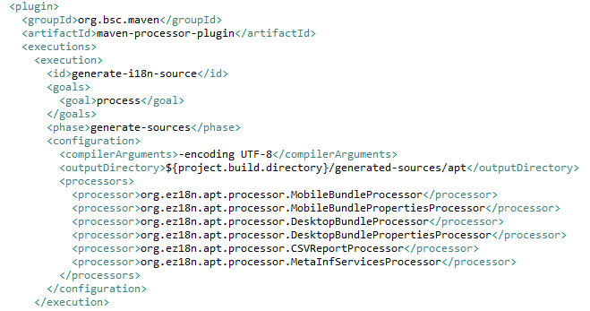
Ez18n - APT chaining
5 APT processors to obtain the default pattern
Optional CSV files for analysis/tooling

Slide 37
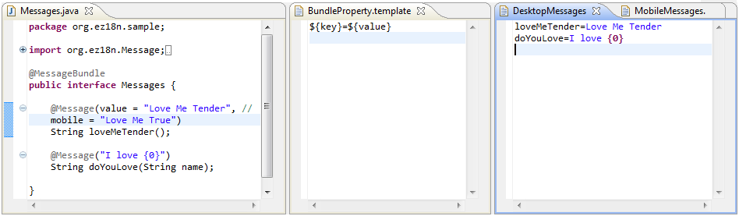
From Messages to DesktopMessages.properties
One property file per interface with @MessageBundle
One property entry per method with @Message

Slide 38
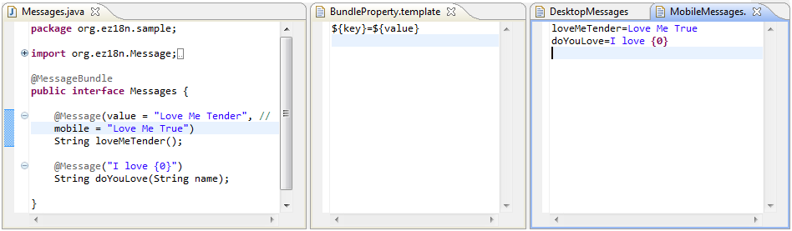
From Messages to MobileMessages.properties
Another property file is generated for the mobile content
If @Message#mobile is empty, the @Message#value is used as fallback

Slide 39
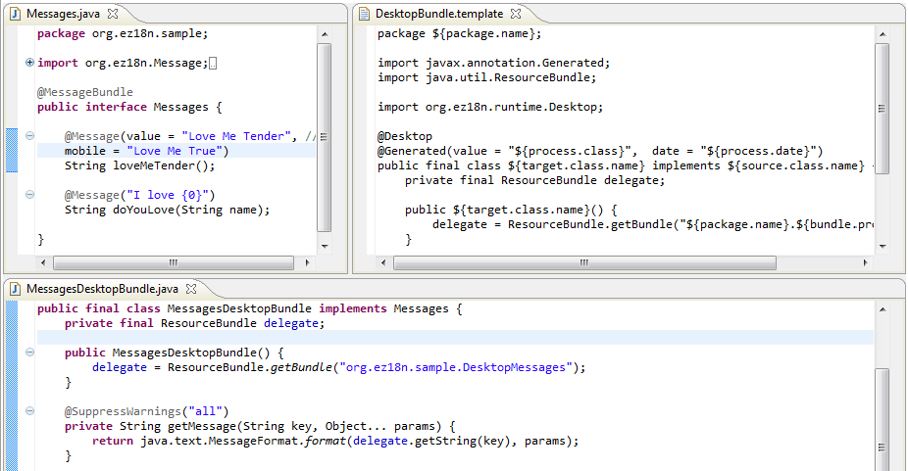
From Messages to MessagesDesktopBundle.java (1/2)

Slide 40
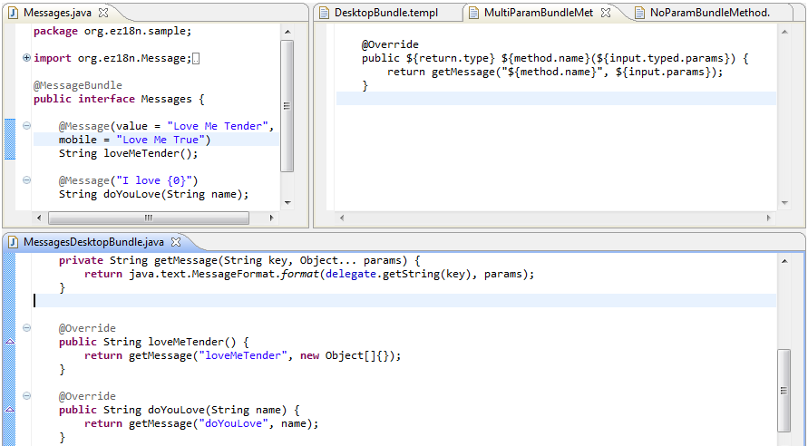
From Messages to MessagesDesktopBundle.java (2/2)

Slide 41
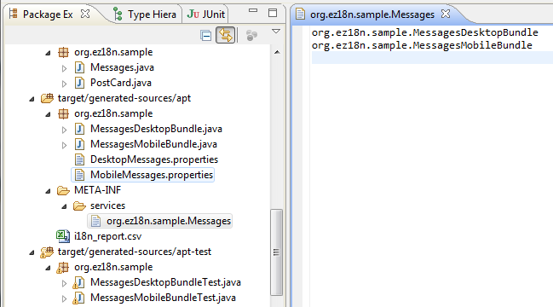
From Messages to META-INF/services/org.ez18n.sample.Messages
Using META-INF/services to inject the mobile & desktop implementation
The two implementation could be filtered at runtime using annotations and ServiceLoader
@Mobile
@Desktop

Slide 42
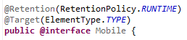
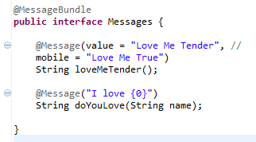
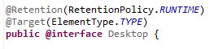
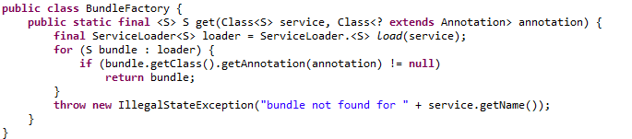
A factory for the Messages implementations
Using java.util.ServiceLoader to inject the interface with @MessageBundle
@Desktop and @Mobile used to filter the injection result

Slide 43
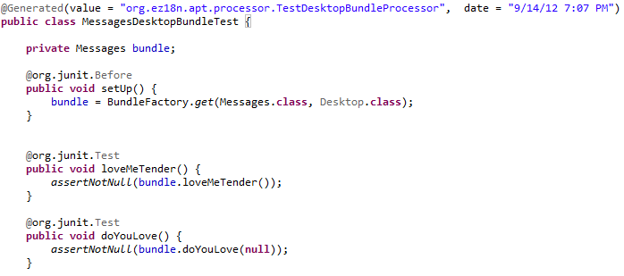
Client code sample with JUnit
Some basic JUnit test using the API
The unit tests are generated using APT too ☺
BundleFactory.get(…) usage in the test @Before to retrieve the bundle implementation

Slide 44
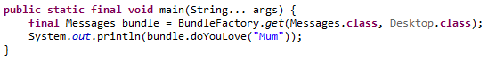
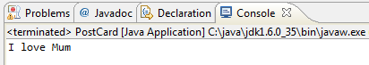
Ez18n - Summary
Maven
Javac & APT

Slide 45

If you think there is room for a JSR Please tell us.

Slide 46


Ez18n is on GitHub. Just fork it !
Thank you !
https://github.com/dbaeli/ez18n

